Slide 1
Parsing methods:
  Top-down parsing
  Bottom-up parsing
  Universal

Slide 2
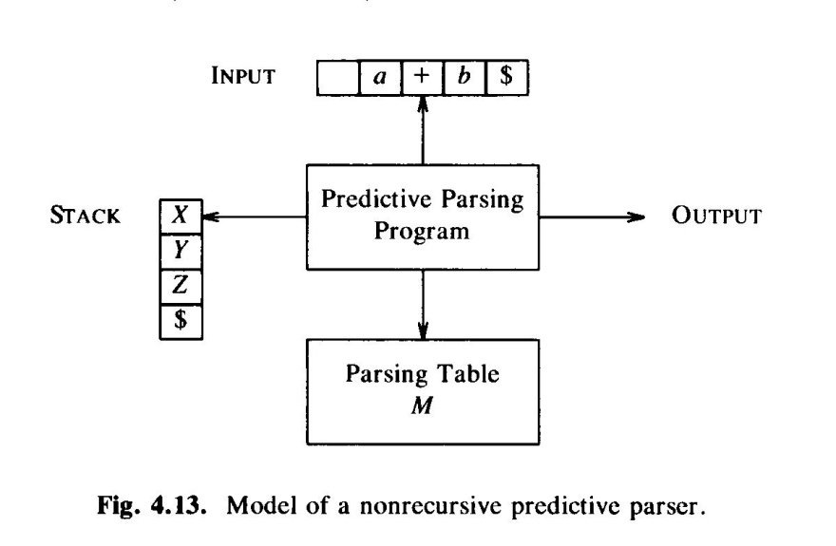
Non recursive predictive parsing
  Predictive parser can be implemented by recursive-descent parsing (may need to manipulate the grammar, e.g eliminating left recursion and left factoring).
    Requirement: by looking at the first terminal symbol that a nonterminal symbol can derive, we should be able to choose the right production to expand the nonterminal symbol.
  If the requirement is met, the parser easily be implemented using a non-recursive scheme by building a parsing table.

Slide 3
A parsing table example
(1) E->TE’
(2) E’->+TE’
(3) E’->e
(4) T->FT’
(5) T’->*FT’
(6) T’->e
(7) F->(E)
(8) F->id
id + * ( ) $
E (1) (1)
E’ (2) (3) (3)
T (4) (4)
T’ (6) (5) (6) (6)
F (8) (7)

Slide 4

Using the parsing table, the predictive parsing program works like this:
  A stack of grammar symbols ($ on the bottom)
  A string of input tokens ($ at the end)
  A parsing table, M[NT, T] of productions
  Algorithm:
  put ‘$ Start’ on the stack ($ is the end of input string).
    1) if top == input == $ then accept
    2) if top == input then
    pop top of the stack; advance to next input symbol; goto 1;
    3) If top is nonterminal
    if M[top, input] is a production then replace top with the production; goto 1
    else error
    4) else error

Slide 5
  Example:
id + * ( ) $
E (1) (1)
E’ (2) (3) (3)
T (4) (4)
T’ (6) (5) (6) (6)
F (8) (7)
(1) E->TE’
(2) E’->+TE’
(3) E’->e
(4) T->FT’
(5) T’->*FT’
(6) T’->e
(7) F->(E)
(8) F->id
Stack input production
$E id+id*id$
$E’T id+id*id$ E->TE’
$E’T’F id+id*id$ T->FT’
$E’T’id id+id*id$ F->id
$E’T’ +id*id$
…...
This produces leftmost derivation:
E=>TE’=>FT’E’=>idT’E’=>….=>id+id*id

Slide 6
How to construct the parsing table?
  First(a): Here, a is a string of symbols. The set of terminals that begin strings derived from a. If a is empty string or generates empty string, then empty string is in First(a).
  Follow(A): Here, A is a nonterminal symbol. Follow(A) is the set of terminals that can immediately follow A in a sentential form.
  Example:
    S->iEtS | iEtSeS|a
    E->b
    First(a) = ?, First(iEtS) = ?, First(S) = ?
    Follow(E) = ? Follow(S) = ?

Slide 7
How to construct the parsing table?
  With first(a) and follow(A), we can build the parsing table. For each production A->a:
    Add A->a to M[A, t] for each t in First(a).
    If First(a) contains empty string
      Add A->a to M[A, t] for each t in Follow(A)
      if $ is in Follow(A), add A->a to M[A, $]
    Make each undefined entry of M error.
  See the example 4.18 (page 191).

Slide 8
Compute FIRST(X)
  If X is a terminal then FIRST(X) = {X}
  If X->e, add e to FIRST(X)
  if X->Y1 Y2 … Yk and Y1 Y2 … Yi-1==>e, where I<= k, add every none e in FIRST(Yi) to FIRST(X). If Y1…Yk=>e, add e to FIRST(X).
  FIRST(Y1 Y2 … Yk): similar to the third step.
E->TE’ FIRST(E) = {(, id}
E’->+TE’|e FIRST(E’)={+, e}
T->FT’ FIRST(T) = {(, id}
T’->*FT’ | e FIRST(T’) = {*, e}
F->(E) | id FIRST(F) = {(, id}

Slide 9
Compute Follow(A).
  If S is the start symbol, add $ to Follow(S).
  If A->aBb, add Frist(b)-{e} to Follow(B).
  If A->aB or A->aBb and b=>e, add Follow(A) to Follow(B).
E->TE’ First(E) = {(, id}, Follow(E)={), $}
E’->+TE’|e First(E’)={+, e}, Follow(E’) = {), $}
T->FT’ First(T) = {(, id}, Follow(T) = {+, ), $}
T’->*FT’ | e First(T’) = {*, e}, Follow(T’) = {+, ), $}
F->(E) | id First(F) = {(, id}, Follow(F) = {*, +, ), $}

Slide 10

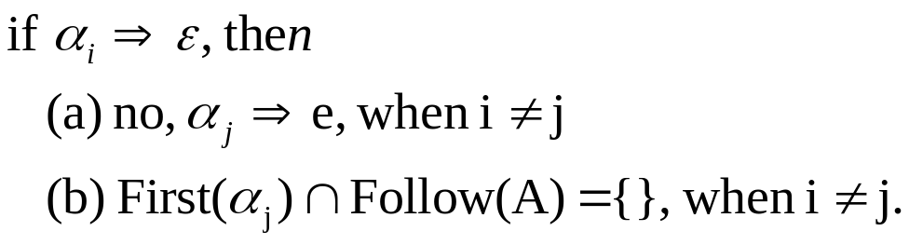
LL(1) grammar:
  First L: scans input from left to right
  Second L: produces a leftmost derivation
  1: uses one input symbol of lookahead at each step to make a parsing decision.
  A grammar whose parsing table has no multiply-defined entries is a LL(1) grammar.
  No ambiguous or left-recursive grammar can be LL(1)
  A grammar is LL(1) iff for each set of A productions, where
  The following conditions hold:

Slide 11
Example, build LL(1) parsing table for the following grammar:
  S-> i E t S e S | i E t S | a
  E -> b

